Slide 1


UNIVERSITY INSTITUTE OF ENGINEERING
COMPUTER SCIENCE & ENGINEERING
Introduction to Information Security and Cryptography
(Subject Code:20CST-354/ITT-354)
Prepared By : Er. Puneet kaur(E6913)
INTRODUCTION
DISCOVER . LEARN . EMPOWER

Slide 2

SHA-512
www. cuchd.in Campus : Gharaun, Mohali

Slide 3
SHA-512
The Secure Hash Algorithm (SHA) was developed by the National Institute of Standards and Technology (NIST) and published as a federal information processing standard (FIPS 180) in 1993.
A revised version was issued as FIPS 180-1 in 1995 and is generally referred to as SHA-1.
In 2002, NIST produced a revised version of the standard, FIPS 180-2,
Three new versions of SHA, with hash value lengths of 256, 384, and 512 bits, known as SHA-256, SHA- 384, and SHA-512.

Slide 4
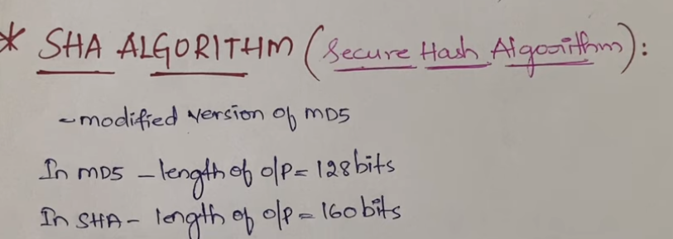

Slide 5
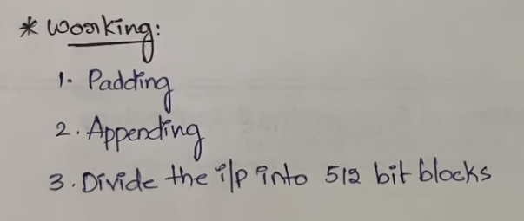

Slide 6
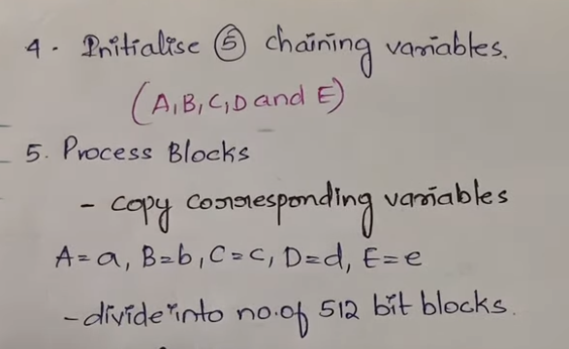

Slide 7
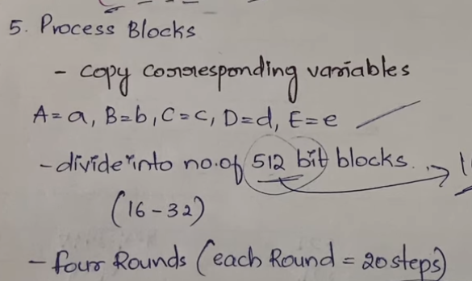

Slide 8
SHA-512
Input Message = Maximum length of less than 2¹²⁸bits.
Output = 512-bit message digest.
The input is processed in 1024-bit blocks.

Slide 9
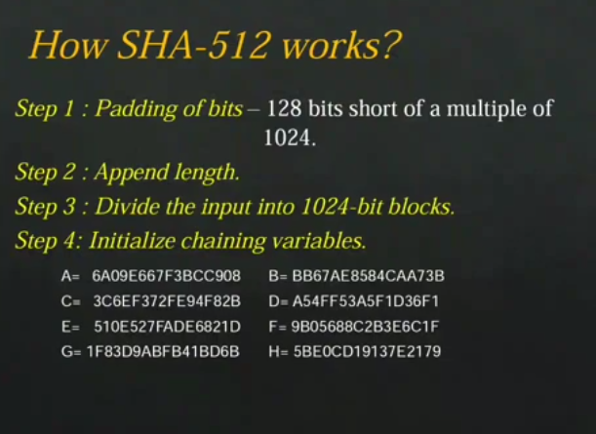

Slide 10
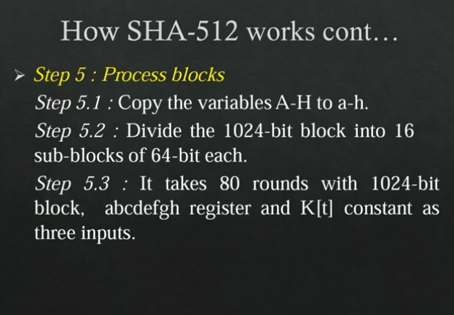

Slide 11
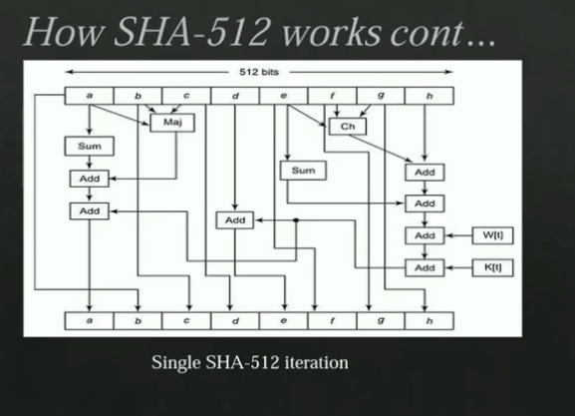

Slide 12
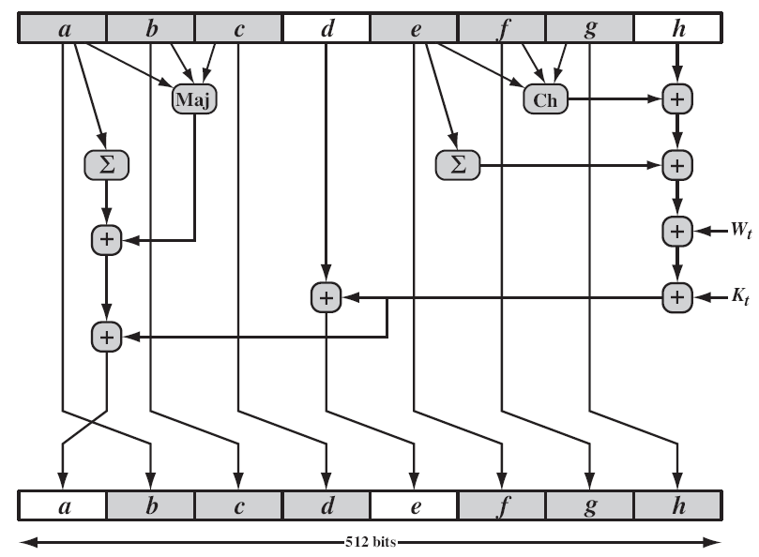
SHA-512

Slide 13
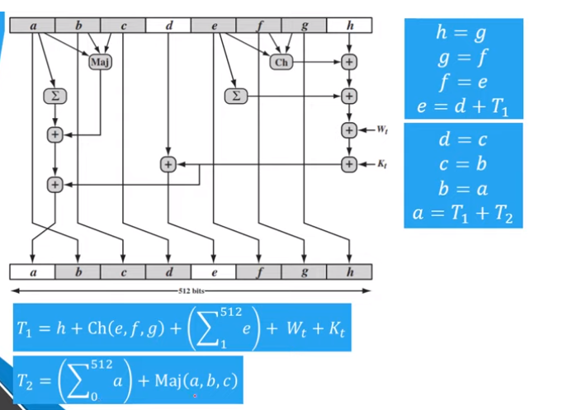

Slide 14
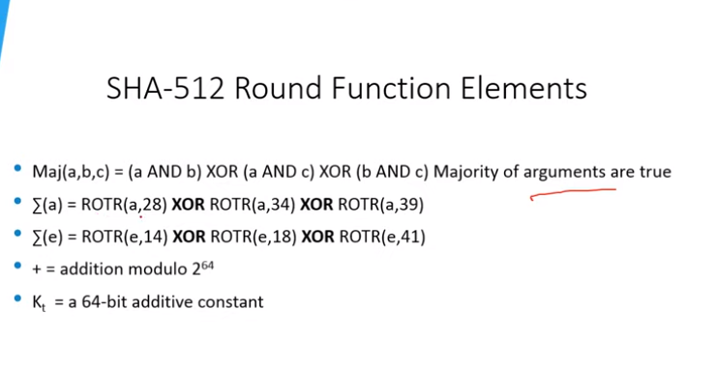

Slide 15
SHA-512
Step-1 (Append padding bits)
The message is padded so that its length is congruent to 896 modulo 1024 .
Padding is always added, even if the message is already of the desired length.
The number of padding bits is in the range of 1 to 1024.
The padding consists of a single 1 bit followed by the necessary number of 0 bits.

Slide 16
SHA-512
Step-2 (Append Length)
A block of 128 bits (L) is appended to the message.
This block contains the length of the original message (before the padding).

Slide 17
SHA-512
Step-3 (Initialize Hash Buffer)
A 512-bit buffer is used to hold intermediate and final results of the hash function.
The buffer can be represented as eight 64-bit registers (a, b, c, d, e, f, g, h).
These registers are initialized to the predefined 64-bit integers (hexadecimal values)

Slide 18
SHA-512
Step-3 (Initialize Hash Buffer)
a = 6A09E667F3BCC908 e = 510E527FADE682D1
b = BB67AE8584CAA73B f = 9B05688C2B3E6C1F
c = 3C6EF372FE94F82B g = 1F83D9ABFB41BD6B
d = A54FF53A5F1D36F1 h = 5BE0CD19137E2179
These values are stored in big-endian format, which is the most significant byte of a word in the low-address (leftmost) byte position.
These words were obtained by taking the first sixty-four bits of the fractional parts of the square roots of the first eight prime numbers.

Slide 19
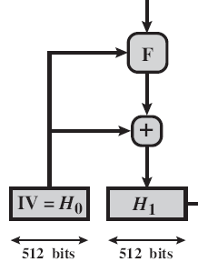
SHA-512
Step-4 (Process message in 1024-bit (128-word) blocks)
This module is labeled as F.
Every F consists of 80 rounds;
Each round takes as input the
512-bit buffer value, abcdefgh,
and updates the contents of the
buffer.

Slide 20
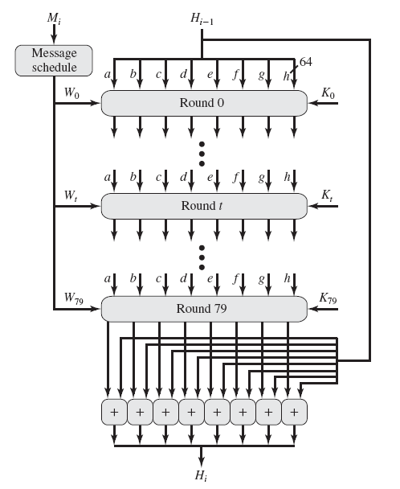
SHA-512
Step-4
Function (F)

Slide 21
SHA-512
Step-4 (Process message in 1024-bit (128-word) blocks)
At input to the first round, the buffer has the value of the intermediate hash value H_{i-1}
Each round makes use of a 64-bit value Wt, derived from the current 1024-bit block being processed.
These values (Wt) are derived using a message schedule.
Each round also makes use of an additive constant Kt, where 0≤Kt ≤ 79 indicates one of the 80 rounds.

Slide 22
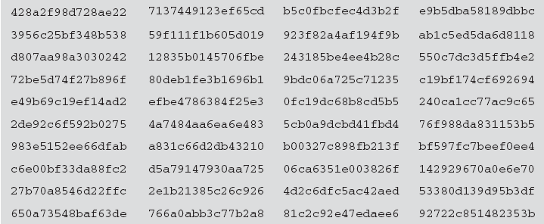
SHA-512
SHA – 512 Constant

Slide 23
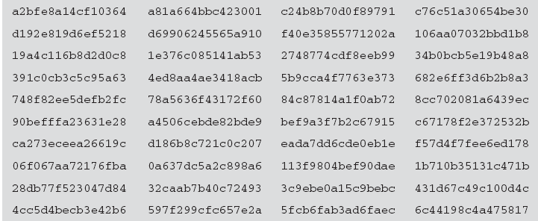
SHA-512
SHA – 512 Constant

Slide 24
SHA-512
Step-4 (Process message in 1024-bit (128-word) blocks)
The output of the eightieth round is added to the input to the first round (H_{i-1}) to produce H_{i}.
SHA-512 Round Function
Every processing function F consists of 80 rounds.

Slide 25
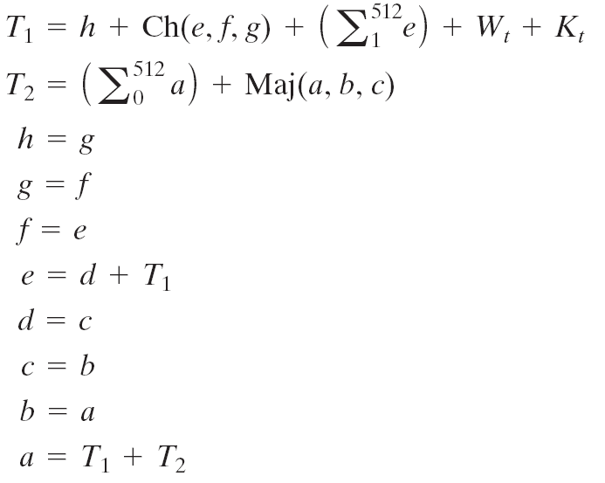
SHA-512

Slide 26
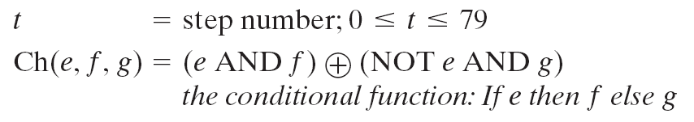
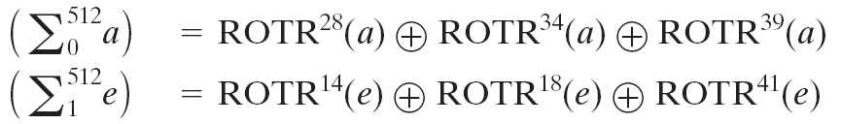
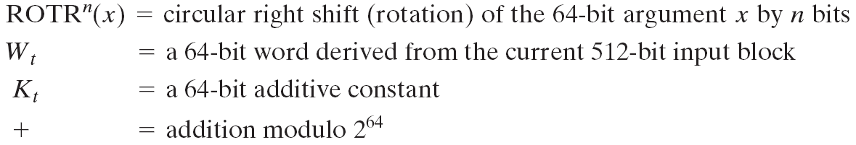
SHA-512

Slide 27
SHA-512
SHA-512 Round Function : Drive Wt
Driving 64 bit Wt from 1024 bit Mi
The first 16 values of Wt are taken directly from the 16 words of the current block.
The remaining values are defined as:

Slide 28
References
http://www.brainkart.com/article/Classical-Encryption-Techniques_8339/
https://www.tutorialspoint.com/cryptography/index.htm
https://www.geeksforgeeks.org/cryptography-introduction/
https://www.techopedia.com/definition/1770/cryptography#:~:text=Cryptography%20involves%20creating%20written%20or,information%20to%20be%20kept%20secret.&text=Information%20security%20uses%20cryptography%20on,transit%20and%20while%20being%20stored.
https://www2.slideshare.net/lineking/classical-encryption-techniques-in-network-security?qid=e388c29f-793d-4f2b-bcaf-9d22e9ca07b5&v=&b=&from_search=1

Slide 29
E- Books Recommended
https://www.pdfdrive.com/cyber-security-books.html
https://bookauthority.org/books/new-cyber-security-ebooks
https://bookauthority.org/books/best-cyber-security-ebooks
https://www.freetechbooks.com/information-security-f52.html

